Slide 1
HL7® FHIR® as a DSTU What happens next?
Lloyd McKenzie
May 22, 2014

Slide 2
This presentation
Can be downloaded here:
http://gforge.hl7.org/svn/fhir/trunk/presentations/2014-05 Webinar/What’s Next webinar.pptx
Use “anonymous” and email address to logon
Is licensed for use under the Creative Commons, specifically:
Creative Commons Attribution 3.0 Unported License
(Do with it as you wish, so long as you give credit)

Slide 3

Who am I?
Name: Lloyd McKenzie
Company: Gordon Point Informatics (GPi)
Background:
One of FHIR’s 3 principle editors
Co-chair FHIR Management Group
Co-chair HL7 Modeling & Methodology
Chair HL7 Canada Architecture & Infrastructure
Heavily involved in HL7 and healthcare exchange for last 15 years (v2, v3, CDA, etc.)

Slide 4
Tutorial Objectives
You should:
Understand where FHIR is in the development cycle
Be able to approach and read the FHIR ballot
Know where and how to ask questions and provide feedback
Be familiar with the plans for future releases and how FHIR is being used in early adoption
Notes:
9:15

Slide 5
FHIR Ballot Types
Draft for Comment
Unstable, still in development
Draft Standard for Trial Use
More stable, ready for early adopters
No commitment to backward compatibility
Normative
Stable – Inter-version compatibility rules apply
Multiple, independent successful production implementations

Slide 6
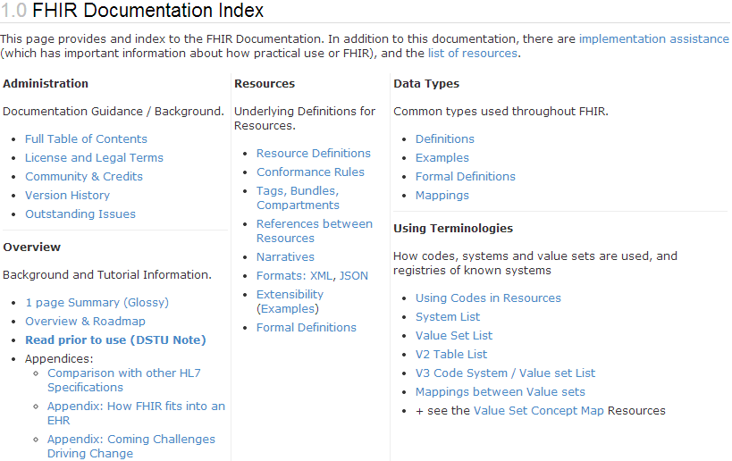
Read me first
“…all aspects of the FHIR specification are potentially subject to change

Slide 7
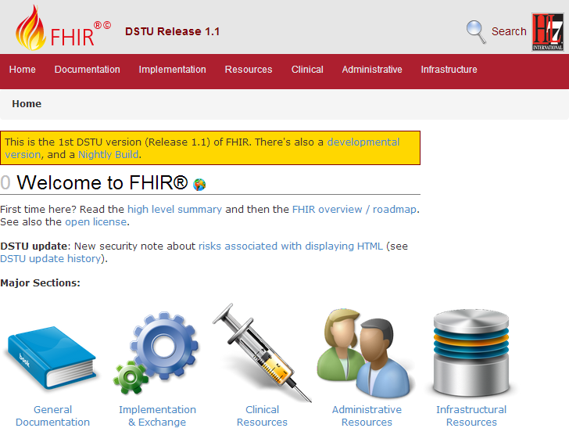
Reading the DSTU
http://hl7.org/fhir
Notes:
How to read:
Web-based
Local web-based
E-book
Links to other releases
Where to start
Table of Contents
Summary
Roadmap
Comparison
Everything under Resources (including Formats)
Data Type Definitions
Using Codes in Resources
Implementation
REST, etc.
Downloads

Slide 8
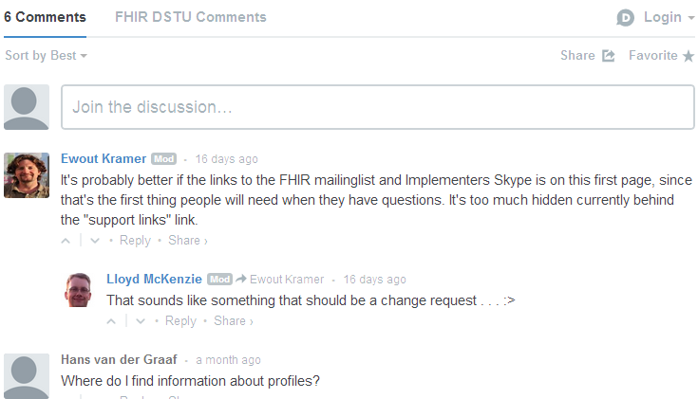
Providing Feedback (inline comment)
In-line comment

Slide 9
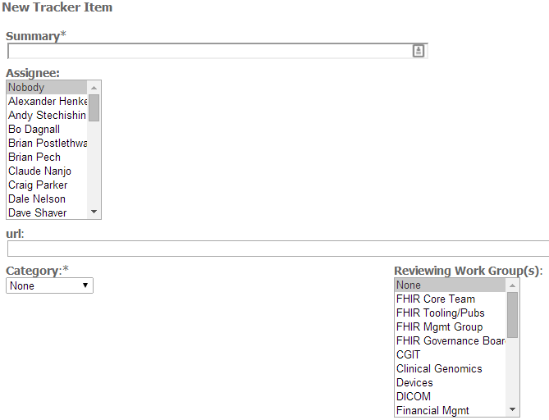

Providing Feedback (Change request)

Slide 10
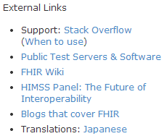
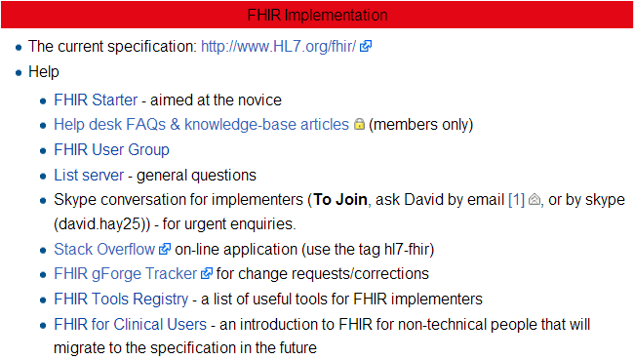
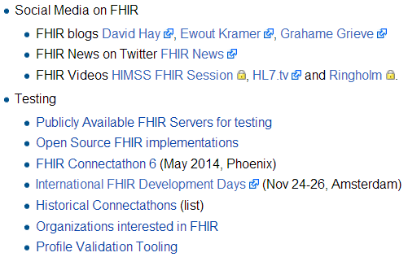
Additional Support Options

Slide 11
Who’s working with FHIR?
~70 organizations declared
attended a Connectathon and/or
signed up on wiki
Aware of many others not on either list
Over 100 participants on the FHIR Implementer’s Skype chat
Probably scared away another 50
20+ countries involved so far

Slide 12
What are they doing?
UK National Health Service
trialing FHIR for Referrals and other areas
US (ONC)
Developing profiles for form exchange and data element standardization
HAPI (HL7 API)
Full support for FHIR as part of their product suite
Orion
Tablet-based nursing medication application

Slide 13
What are they doing? (cont’d)
Smart Systems for Health
Medical apps that communicate using FHIR
IHE
Profiles for PIX/PDQ, MHD (RESTful XDS)
DICOM
FHIR profiles for imaging
Notes:
We’ve probably scared another 50+ away with the volume

Slide 14
Timeline
2011-09 – Conceptual first draft published
2012-09 – 1st “draft for comment” ballot
2013-09 – 1st DSTU ballot
2014-01 – 1st DSTU published
2015-03 – 2nd DSTU published (approx)
2016? – First normative version
Additional normative releases every 1-2 years

Slide 15
DSTU 2
Publish around end of March 2016
Expected content includes:
Updates to existing content
Check tracker for proposal and agreed changes
Additional capabilities
Publish/subscribe, Web-based “push”
New resources
Referral, Coverage, Claim, Diet, Common Data Element
Profiles for CCDA 1.1

Slide 16
Normative FHIR
Will include
Core specification
Syntax
RESTful interface
Structural resources + subset of others
Some resources won’t go normative right away
Future releases
Add more resources
Add profiles on existing resources
May add elements to resources
Very rare

Slide 17
Engagement opportunities
Read the spec: http://hl7.org/fhir
Follow #FHIR on Twitter
Shape the specification:
Make comments (inline, tracker, wiki, etc.)
Try implementing it
Make Ballot comments
Come to a Connectathon!

Slide 18


Education opportunities
Attend a Working Group Meeting
Tutorials, Connectathons
Sept 12-19 Chicago
Jan 16-23 San Antonio
Attend an Implementation Workshop
Intensive tutorials, hands-on
July 7-10 Cambridge
November 10-13 Portland
FHIR Institute Webinars
Watch for updates in the HL7 News Bulletin
Latin American Connectathon – Sept. 3
http://www.cais.org.ar/?q=node/20

Slide 19






International HL7 FHIR Developer Days November 24-26, 2014 in Amsterdam
Education
14 tutorials
pick & choose
Connectathon
Meet fellow developers
Put FHIR to the test
Networking
FHIR experts and authors on hand
http://fhir.furore.com/devdays

Slide 20

Questions?
http://hl7.org/fhir lloyd@lmckenzie.com

